Slide 1
MISINFORMATION MATRIX
Based on Carl Sagan’s Demon Haunted World

Slide 2
Summary:
The "Misinformation Matrix" presentation aims to enlighten and engage the audience on the critical issue of misinformation in the digital age. Drawing inspiration from Carl Sagan's wisdom, the presentation explores the complexities of digital narratives, the impact of social media and AI on our perception of truth, and the importance of critical thinking. It concludes with a call to action, urging the audience to foster a culture of truth and skepticism, thereby upholding the legacy of enlightenment and informed discourse in our digital era.

Slide 3
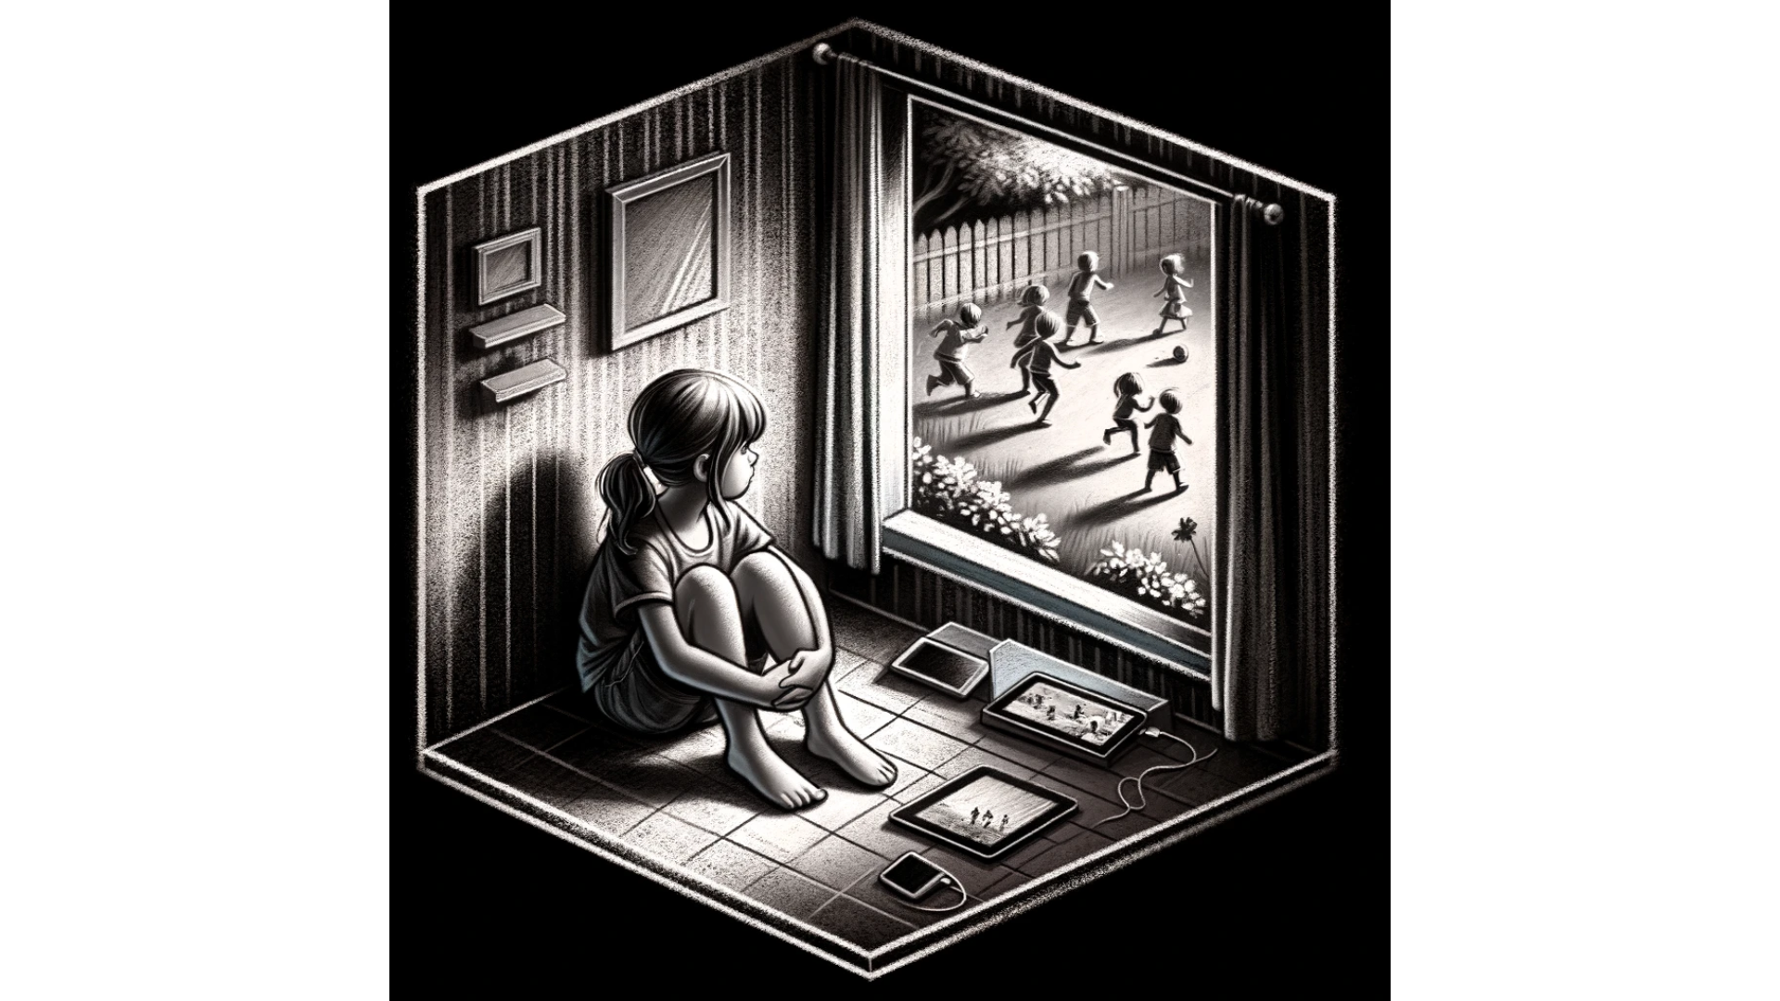
The Digital Disconnect

Slide 4
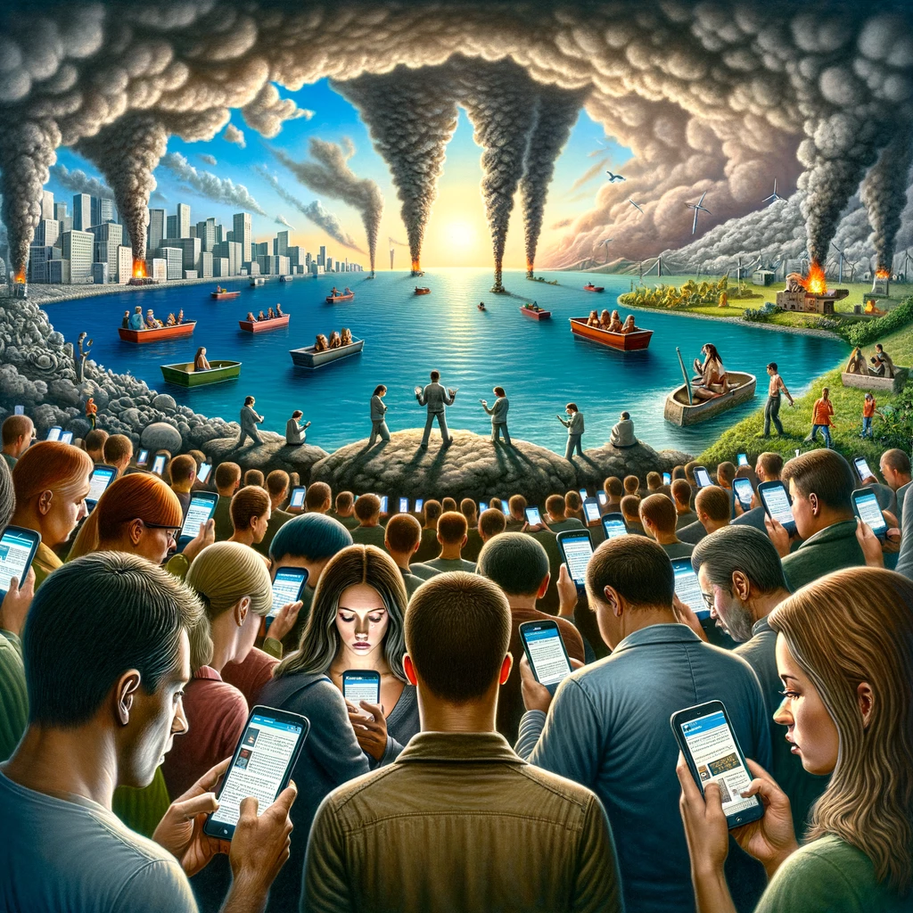
The Allure of Digital Misinformation

Slide 5
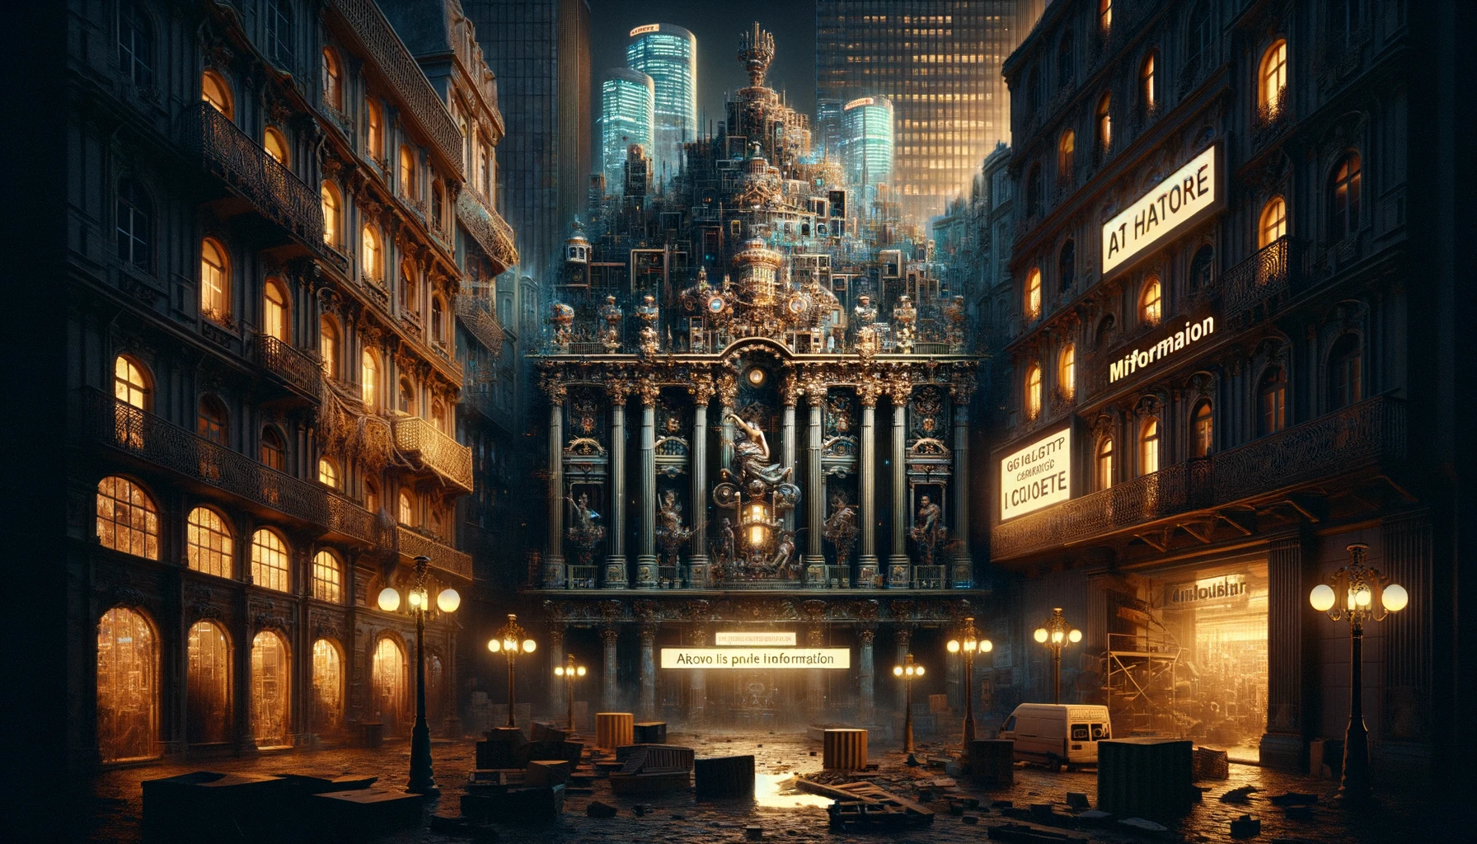
Artistic Representations of Misinformation

Slide 6
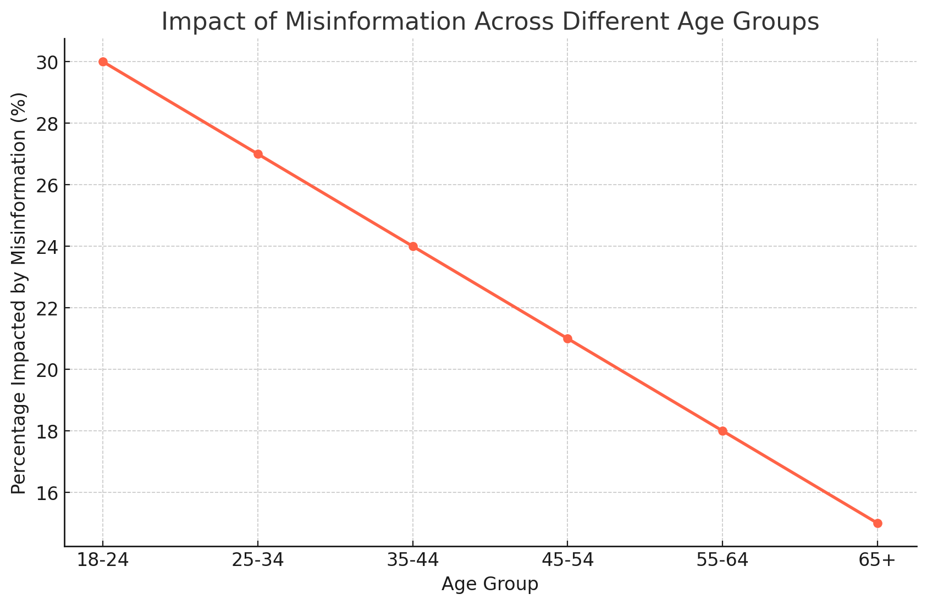
The Echo Chambers of Social Media

Slide 7
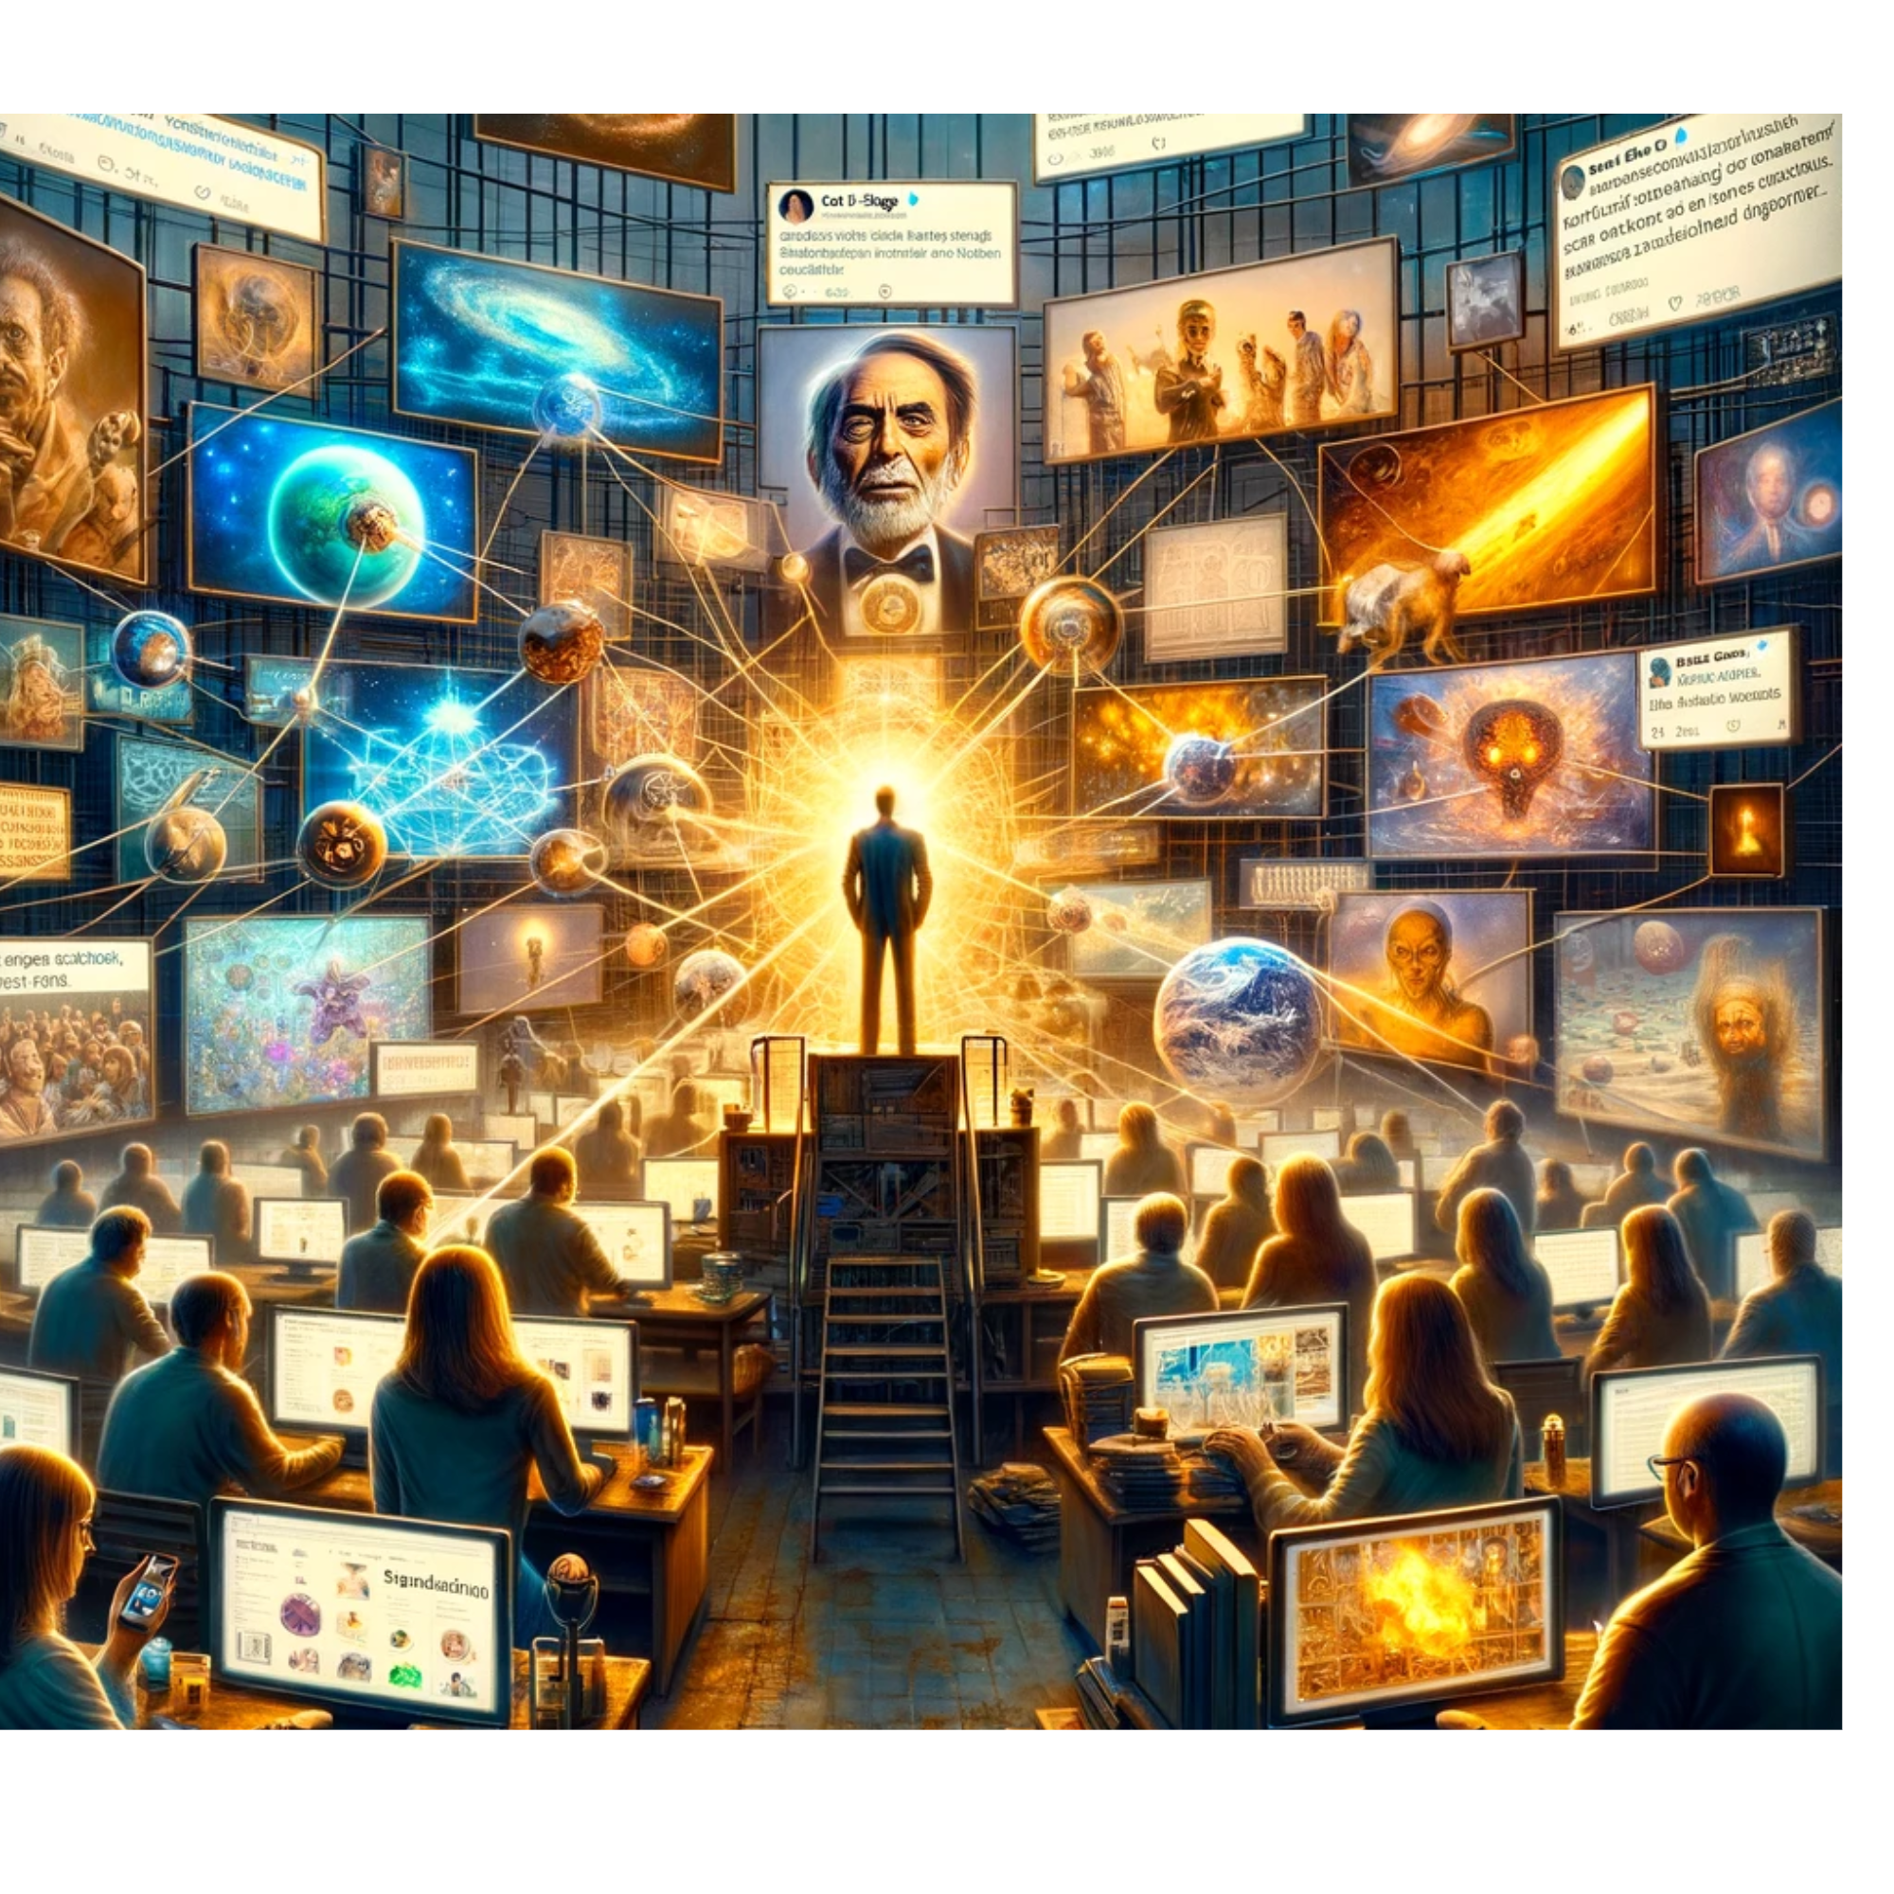
The Role of AI and Misinformation

Slide 8
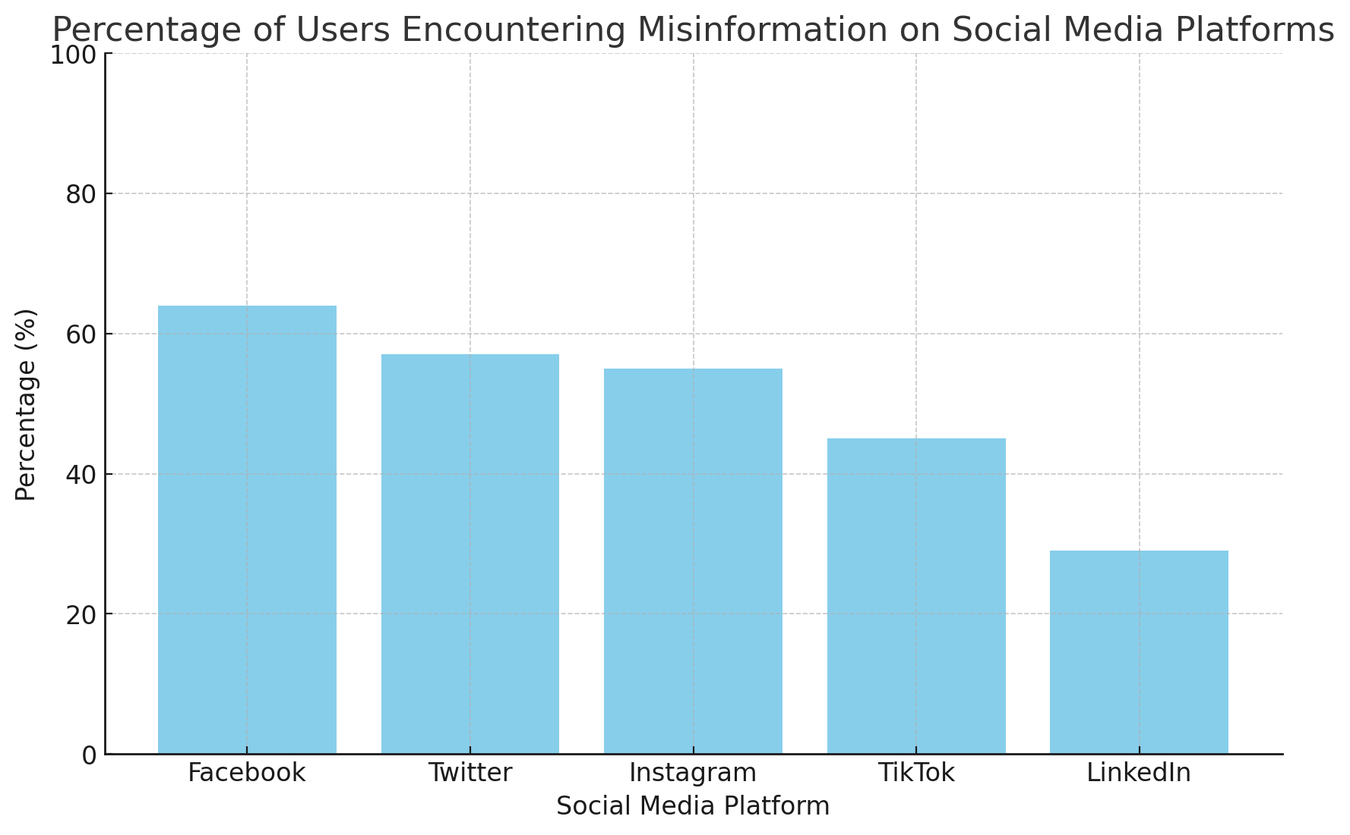
The Carl Sagan Perspective

Slide 9
The End
This presentation explores the complex world of misinformation in the digital age, combining insights from Carl Sagan's work with contemporary issues in social media and AI. It provides a comprehensive view of how misinformation spreads and impacts different demographics, urging the audience to foster a culture of skepticism and truth-seeking in today's information-saturated world.

